Slide 1
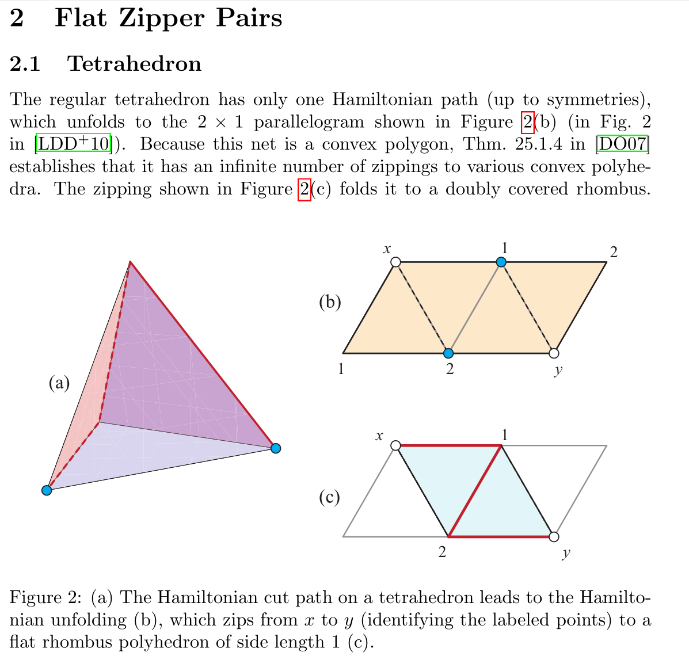
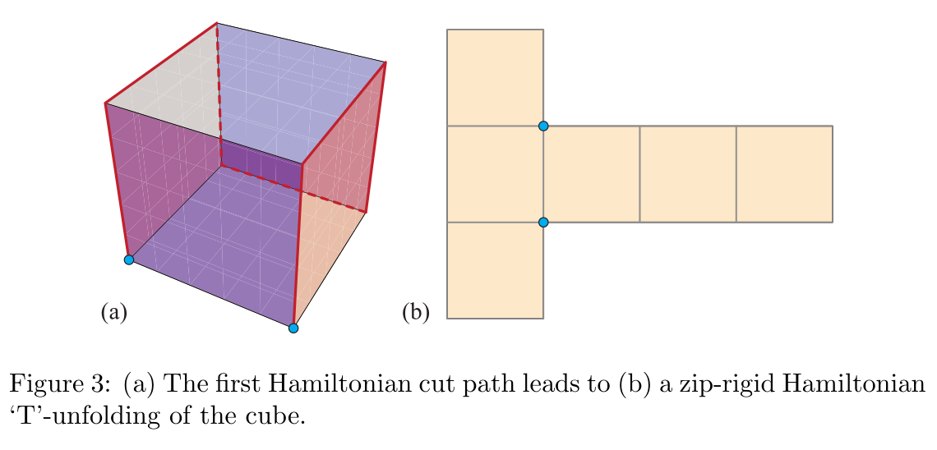
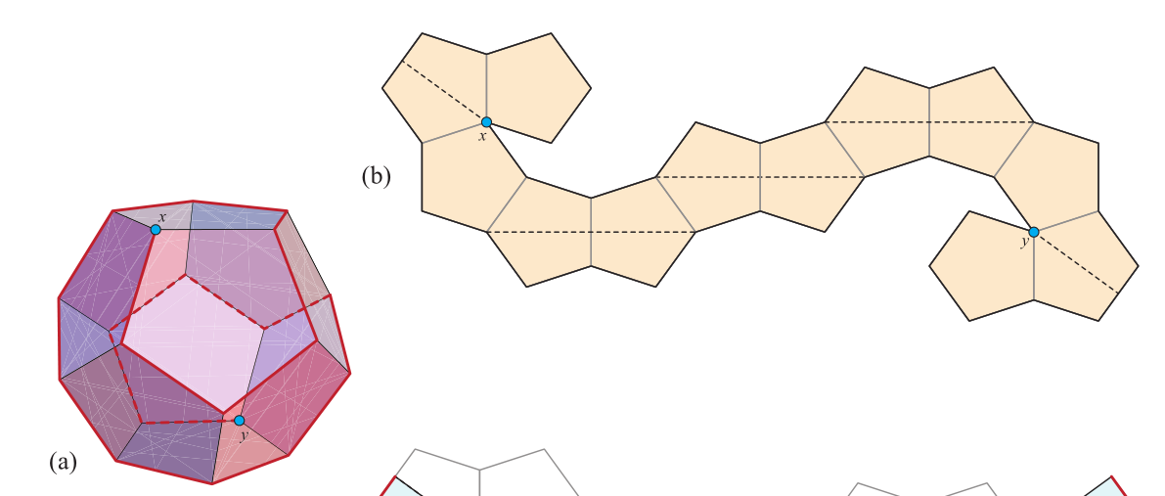
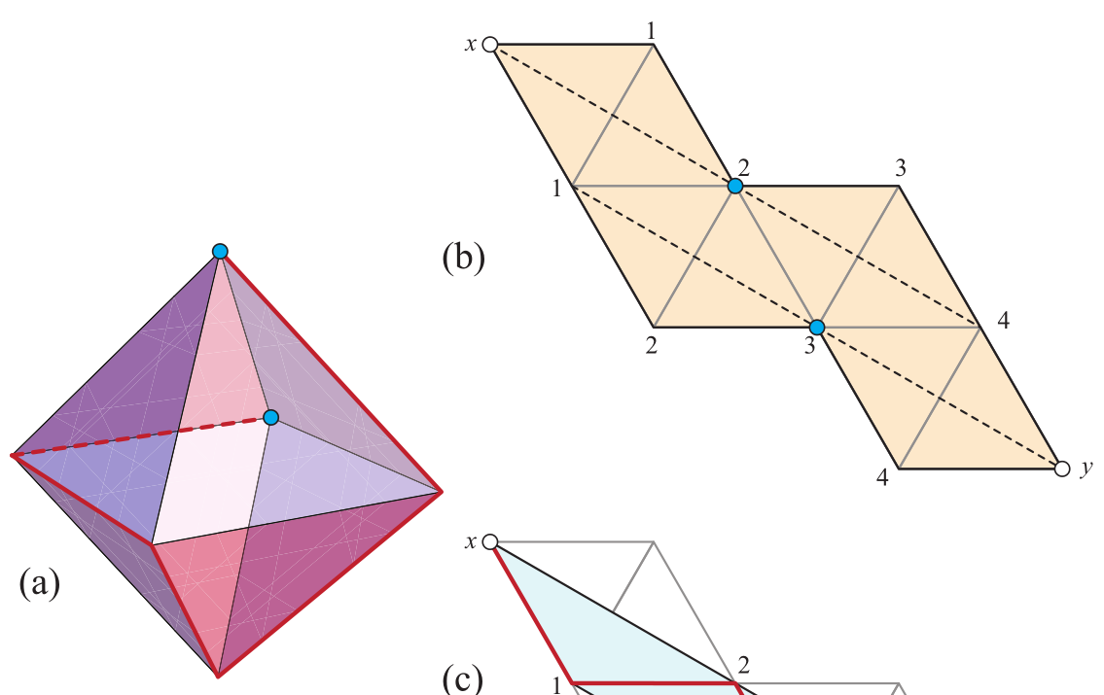
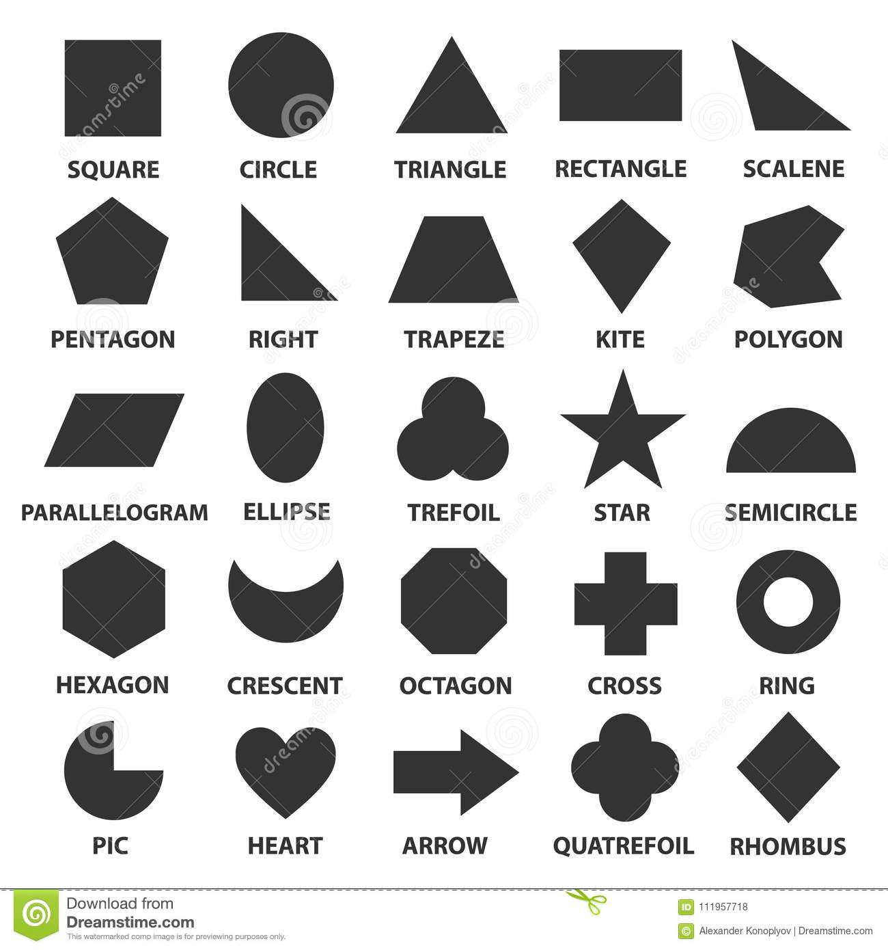
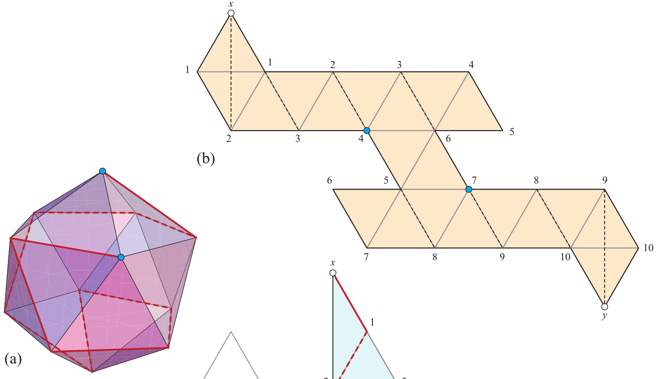
From Paper: 2018 Flat Zipper-Unfolding Pairs for Platonic Solids
Notes:
- Draw different types of unfolding to each types of platonic solids in order to talk about the discretise of surface into triangule or square or pentagon grid

Slide 2
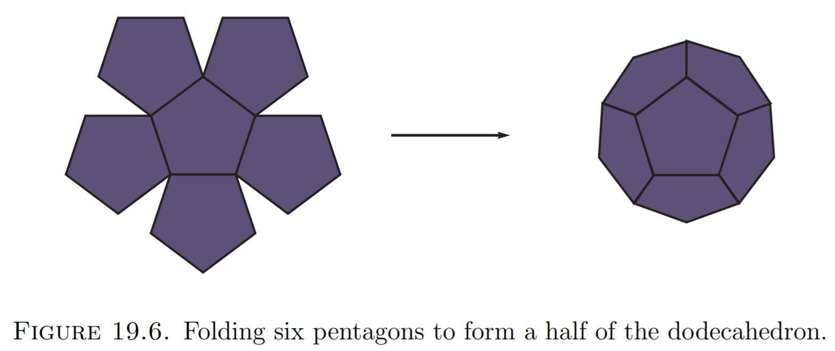
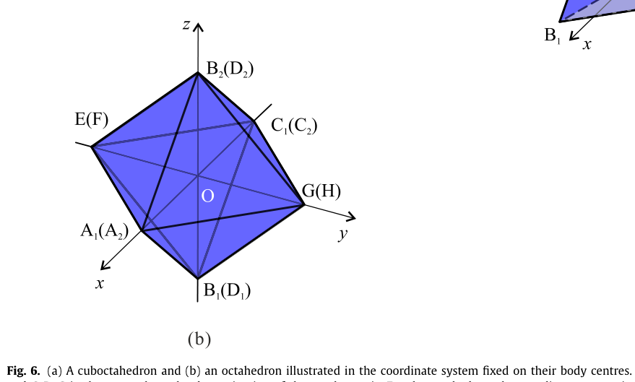
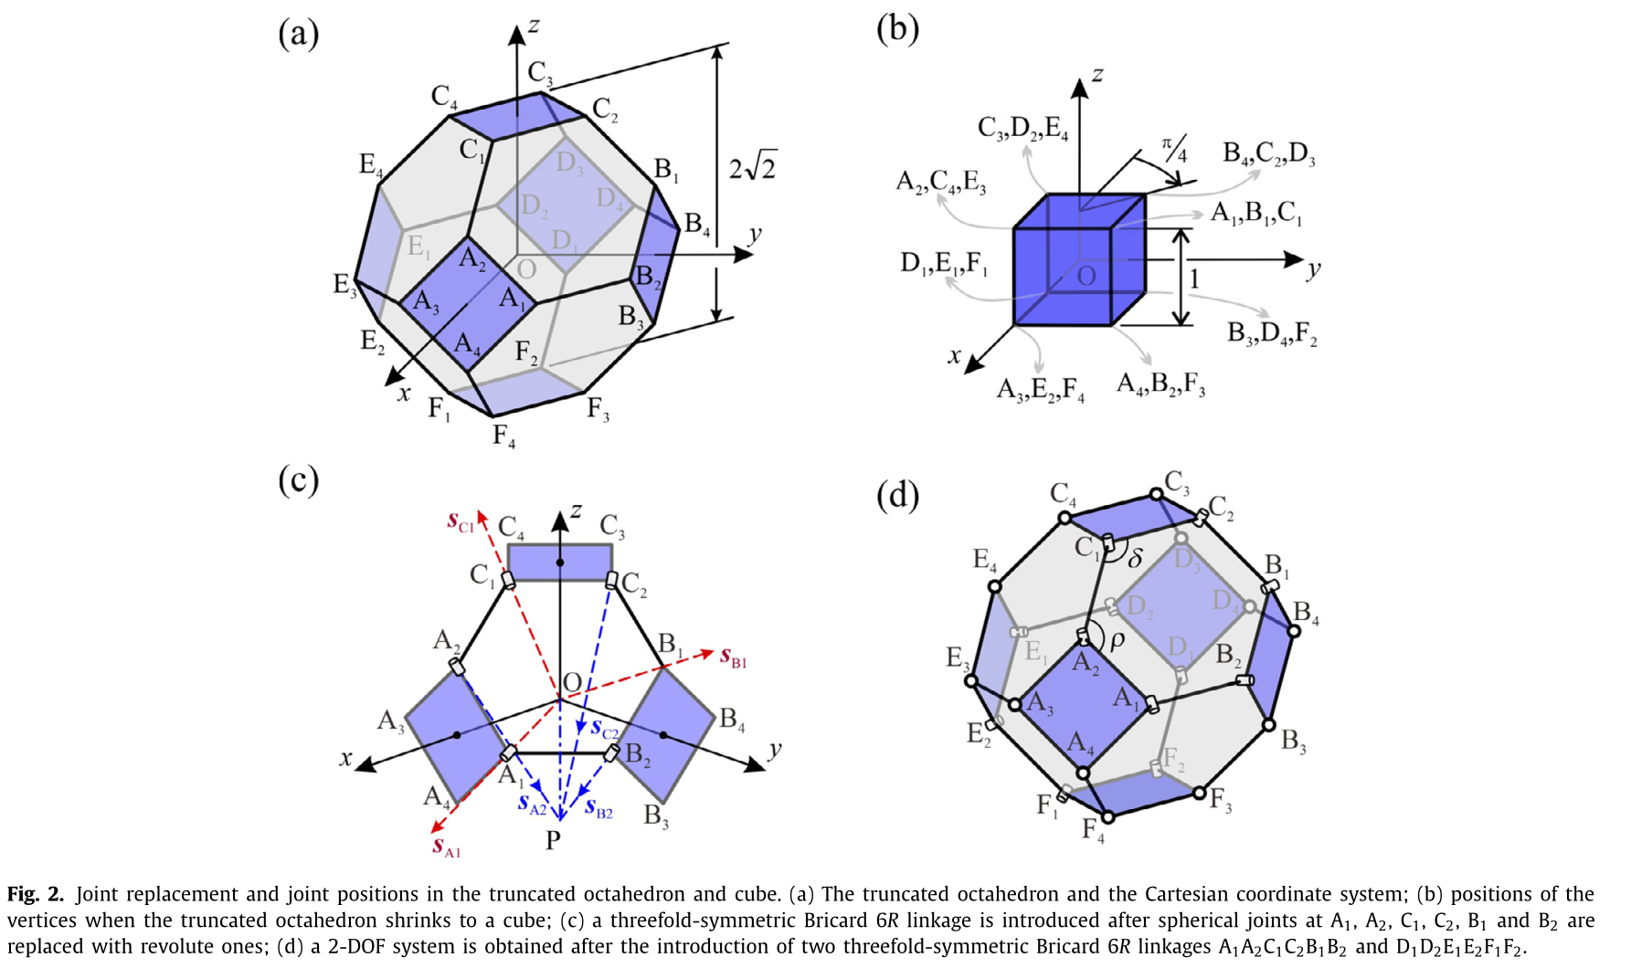
From 2018-2020 Tranformation of polyhedron

Slide 3
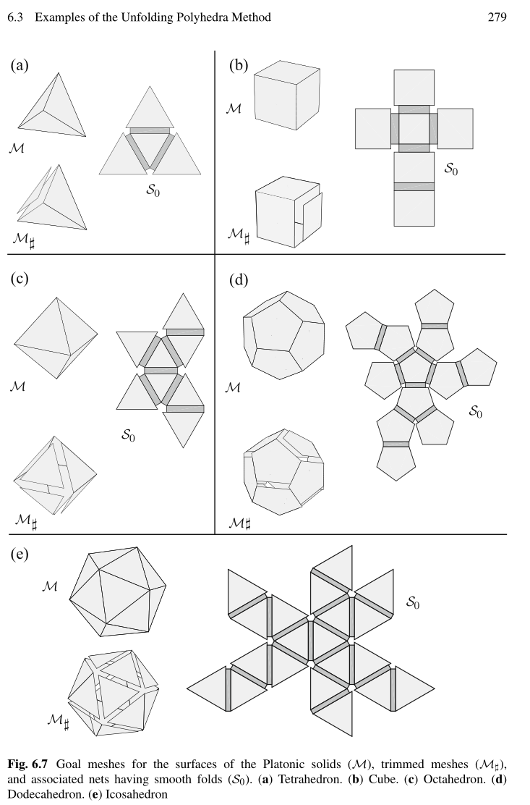
From 2018 perazahernandez- Unfolding Polyhedra Method.pdf

Slide 4
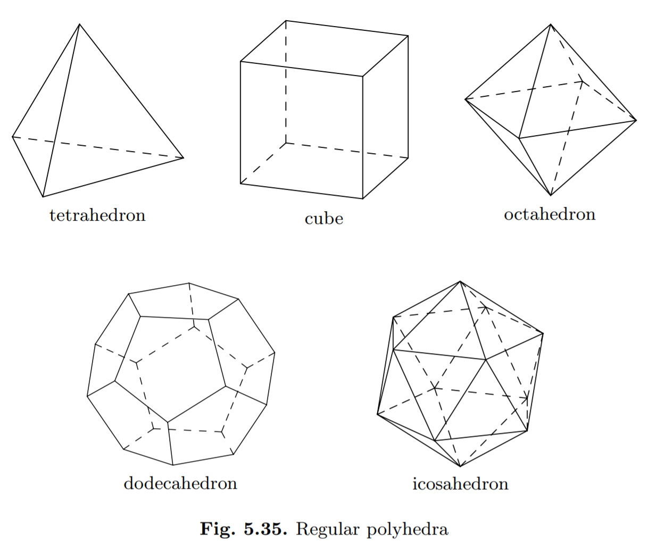
2008_Book - Plane and Solid Geometry.pdf from GoogleDrive

Slide 5
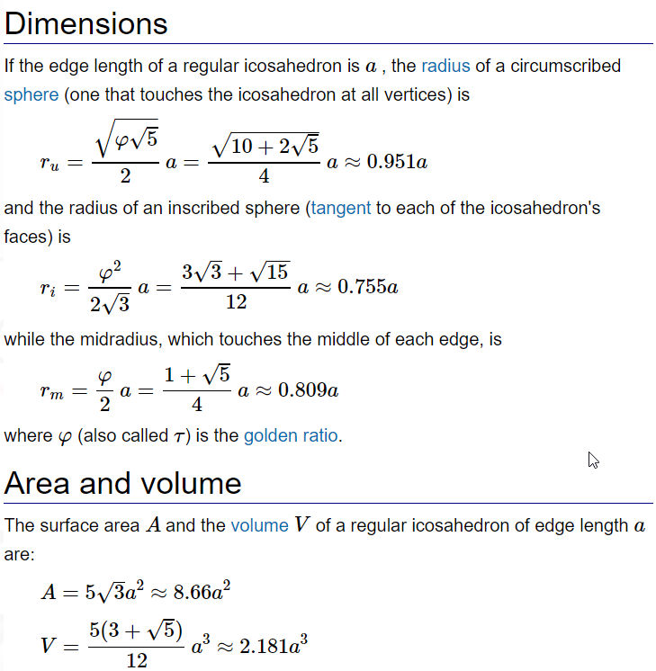
The regular icosahedron is one of the five Platonic solids.
It is a convex regular polyhedron composed of twenty triangular faces, with five meeting at each of the twelve vertices.
It has 30 edges and 12 vertices.
From: https://math.wikia.org/wiki/Icosahedron

Slide 6
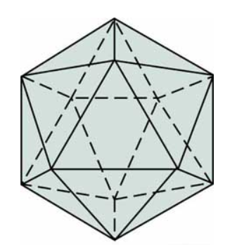
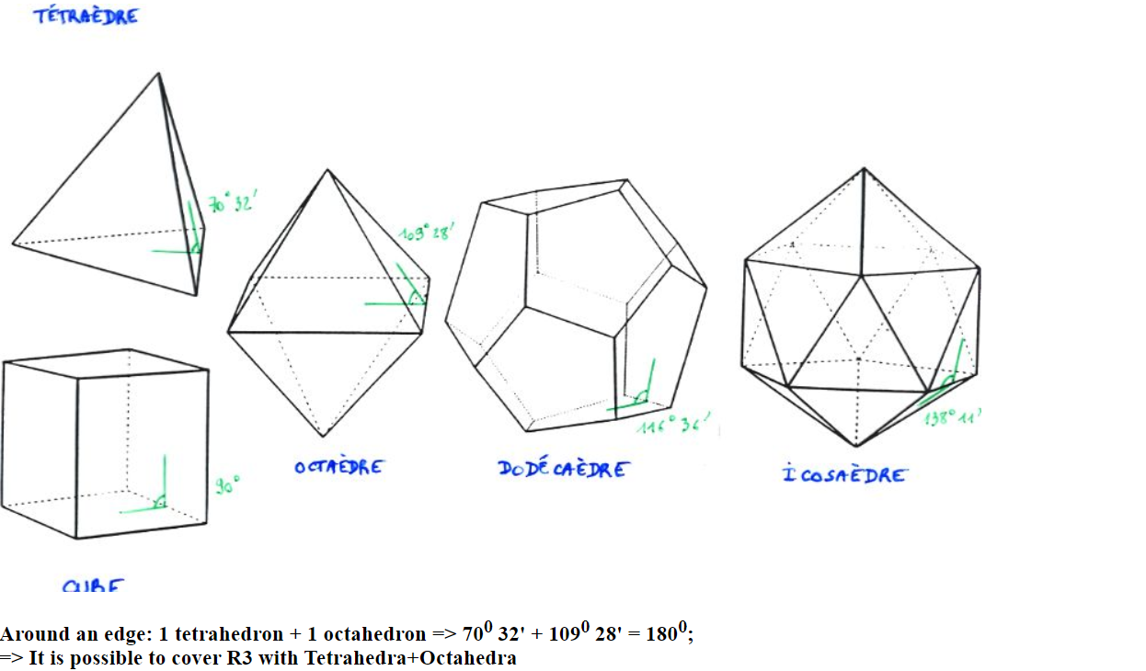
https://www.ljll.math.upmc.fr/perronnet/delaunay3d/delaunay3d.html

Slide 7
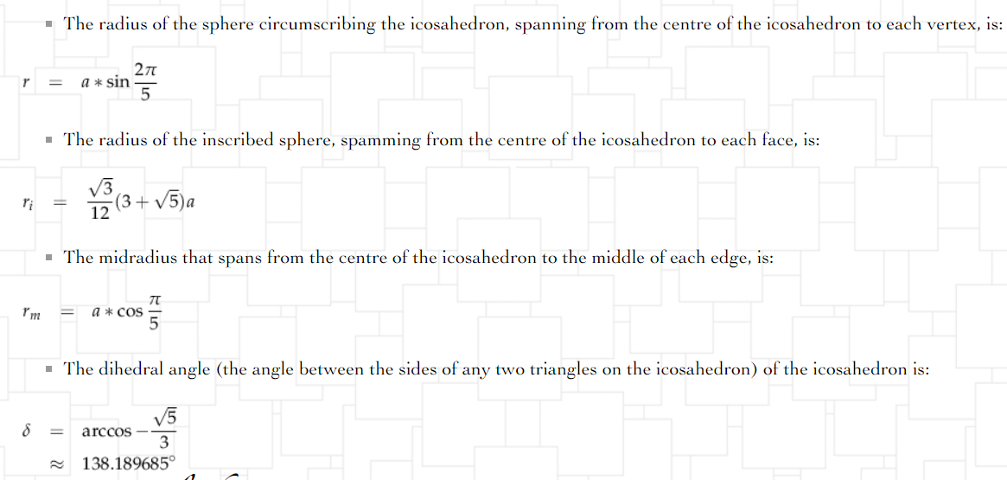
http://grimore.org/fuss/mathematics/geometry/icosohedron/regular

Slide 8
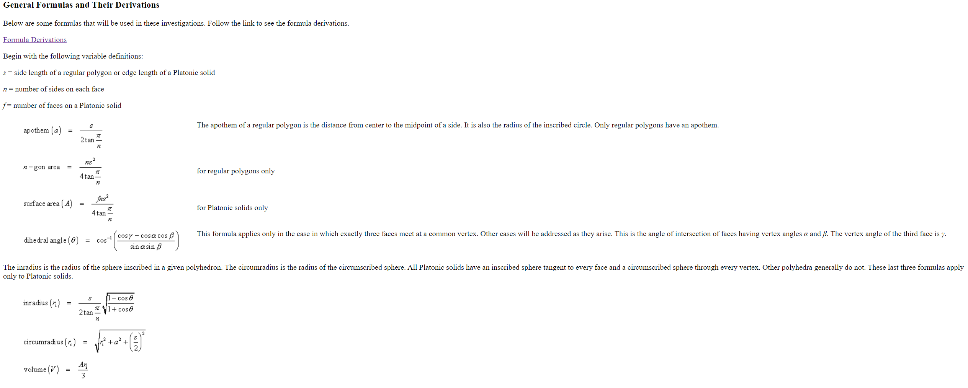
http://whistleralley.com/polyhedra/platonic.htm

Slide 9
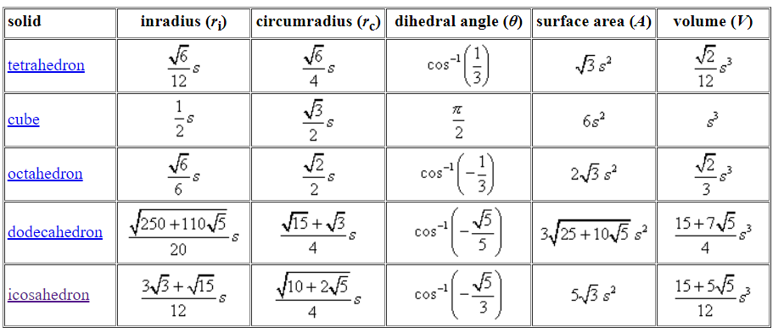
http://whistleralley.com/polyhedra/platonic.htm

Slide 10
Visualization Icosahedron: https://www.mathopenref.com/icosahedron.html

Slide 11
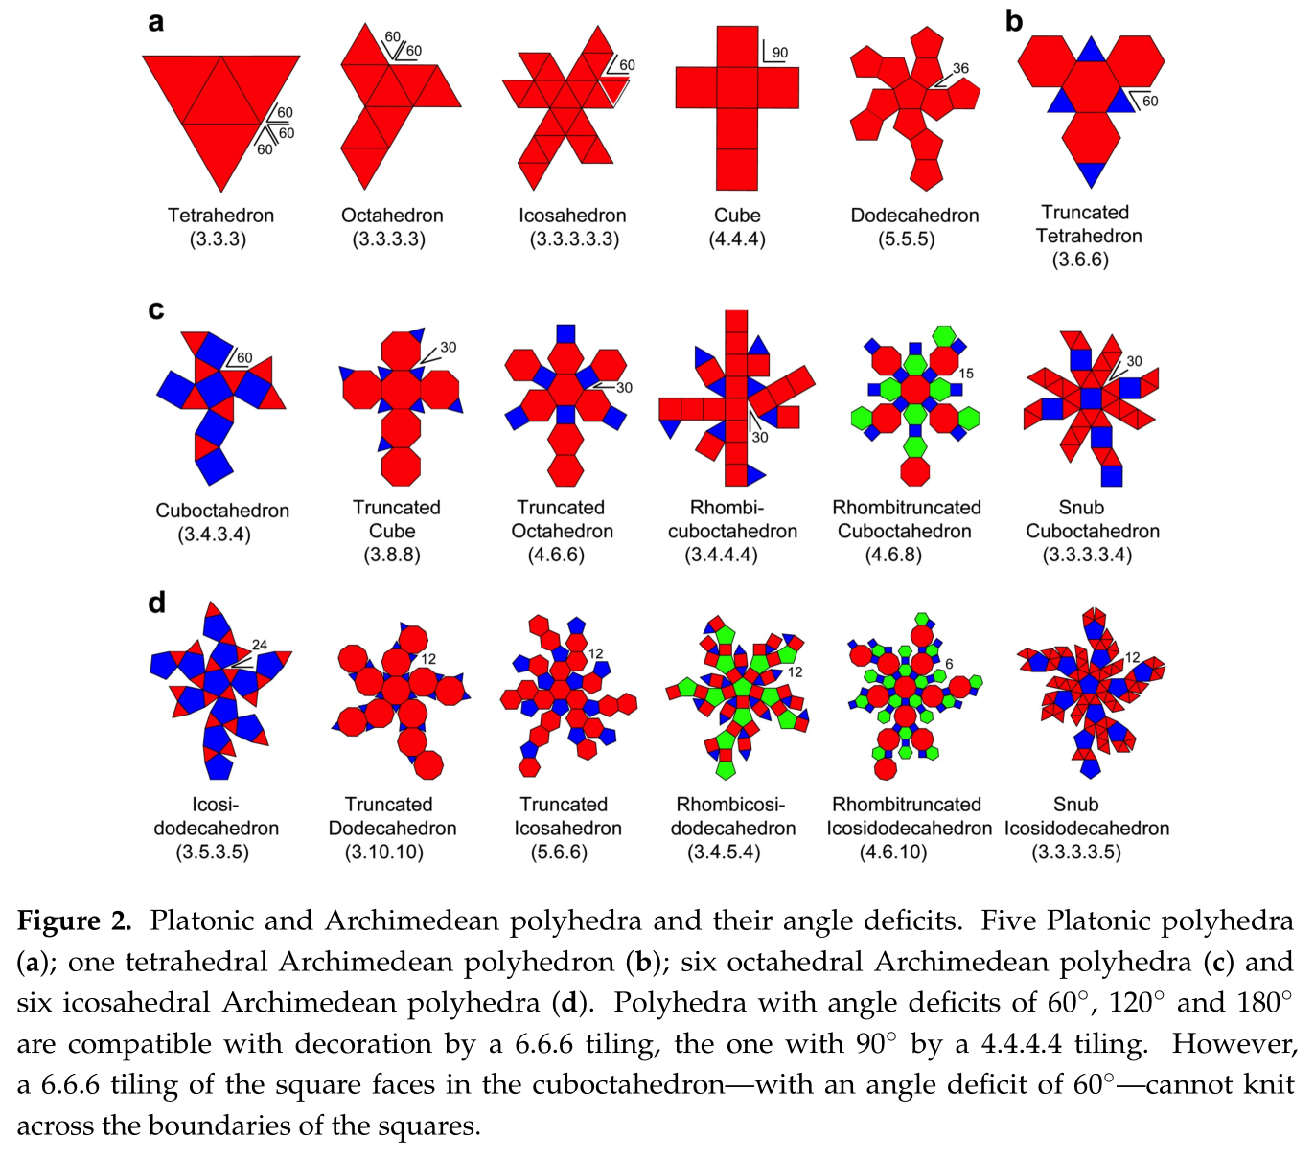
Paper: Decoration of the Truncated Tetrahedron

Slide 12
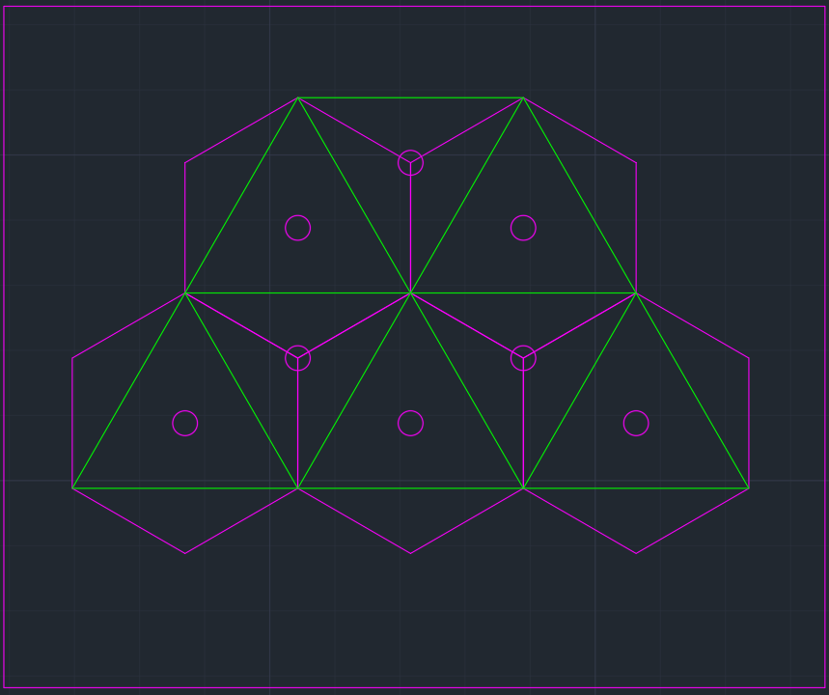
doi:10.1209/0295-5075/92/68004 Icosahedral formation of nano-micro capsules: An energetic viewpoint

Slide 13
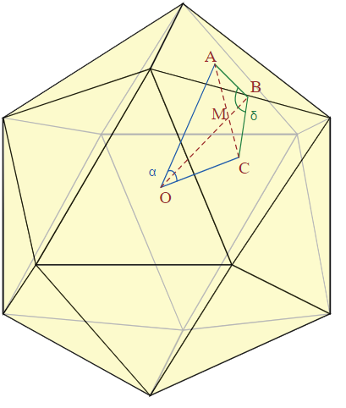
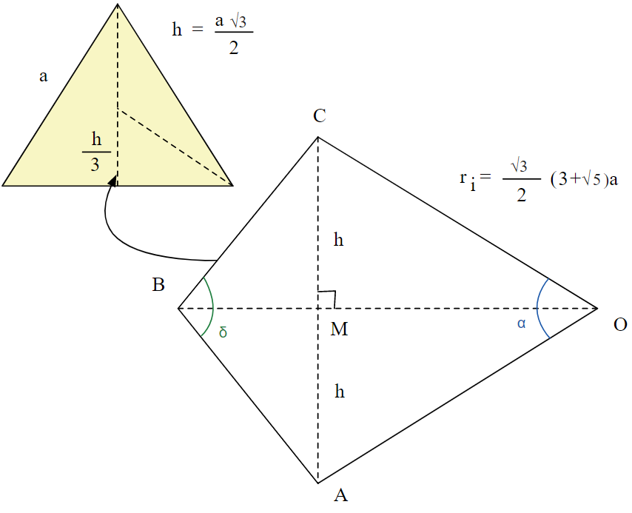
http://grimore.org/fuss/mathematics/geometry/icosohedron/regular
Inner Angle between faces
We want to determine which is the inner angle between two segments that connect the centre of the icosahedron to the centre of two adjacent triangles.
In order to do that, we observe the kite formed by the points :

Slide 14
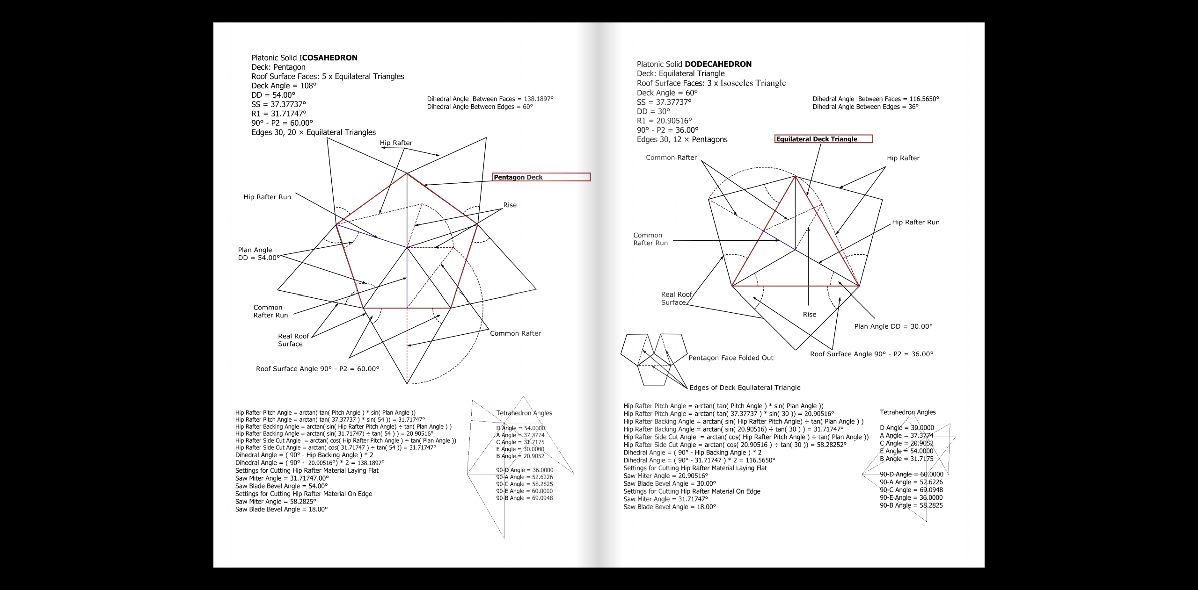

Slide 15
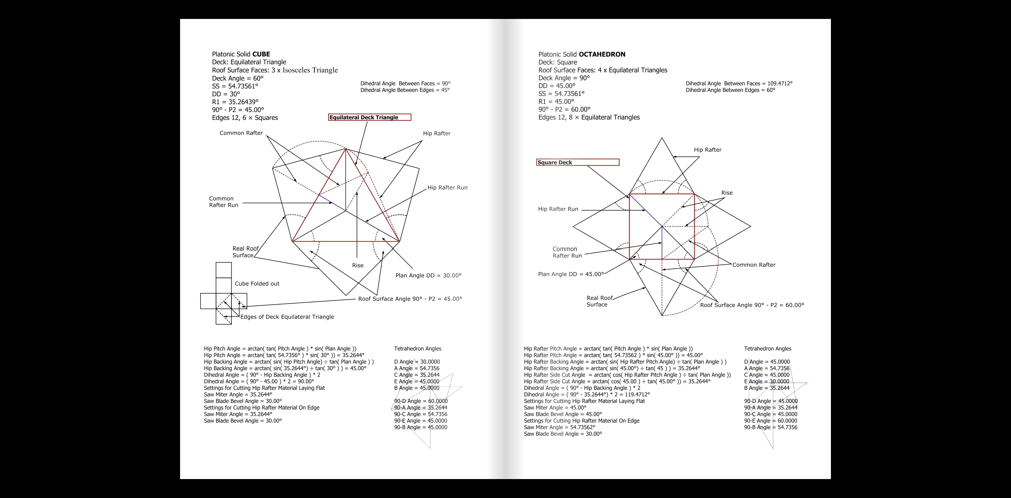

Slide 16
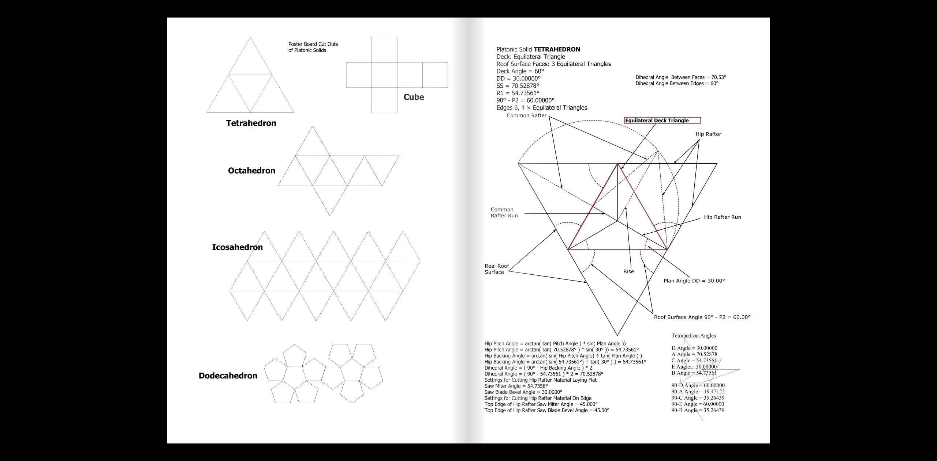

Slide 17
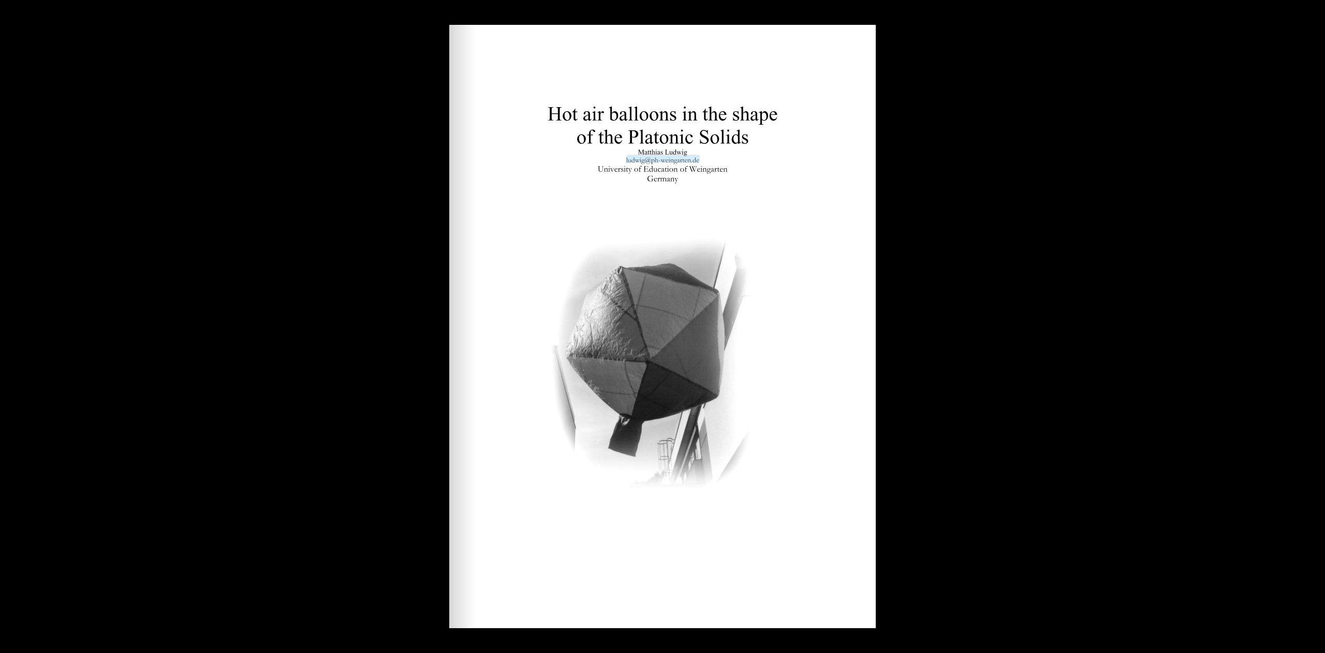

Slide 18
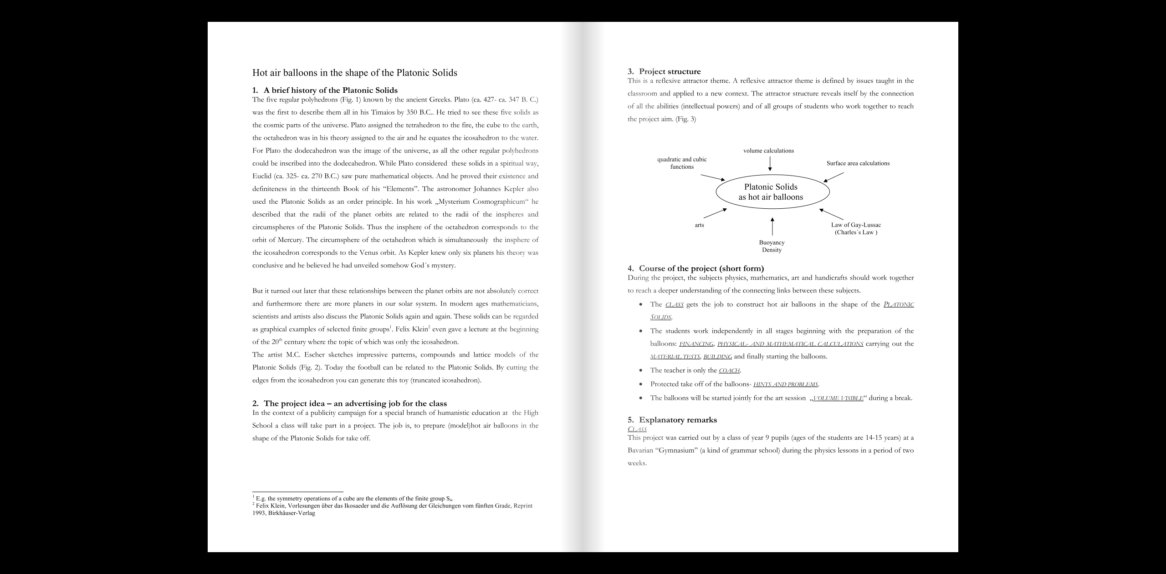

Slide 19
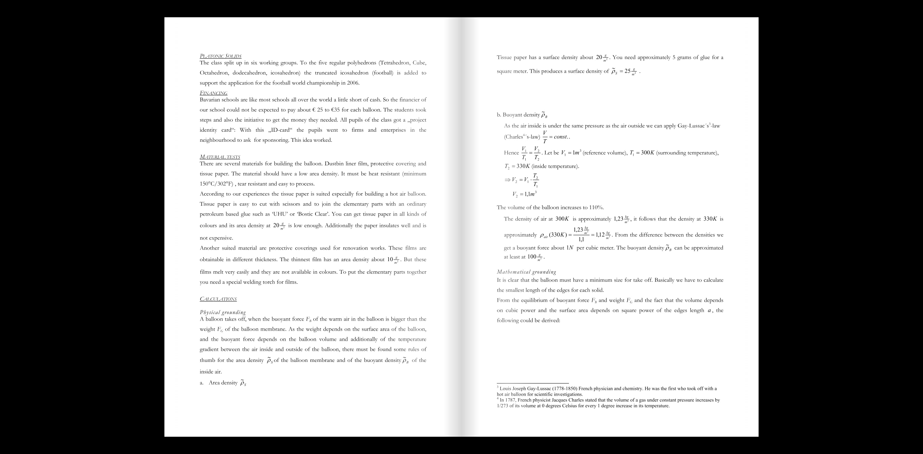

Slide 20
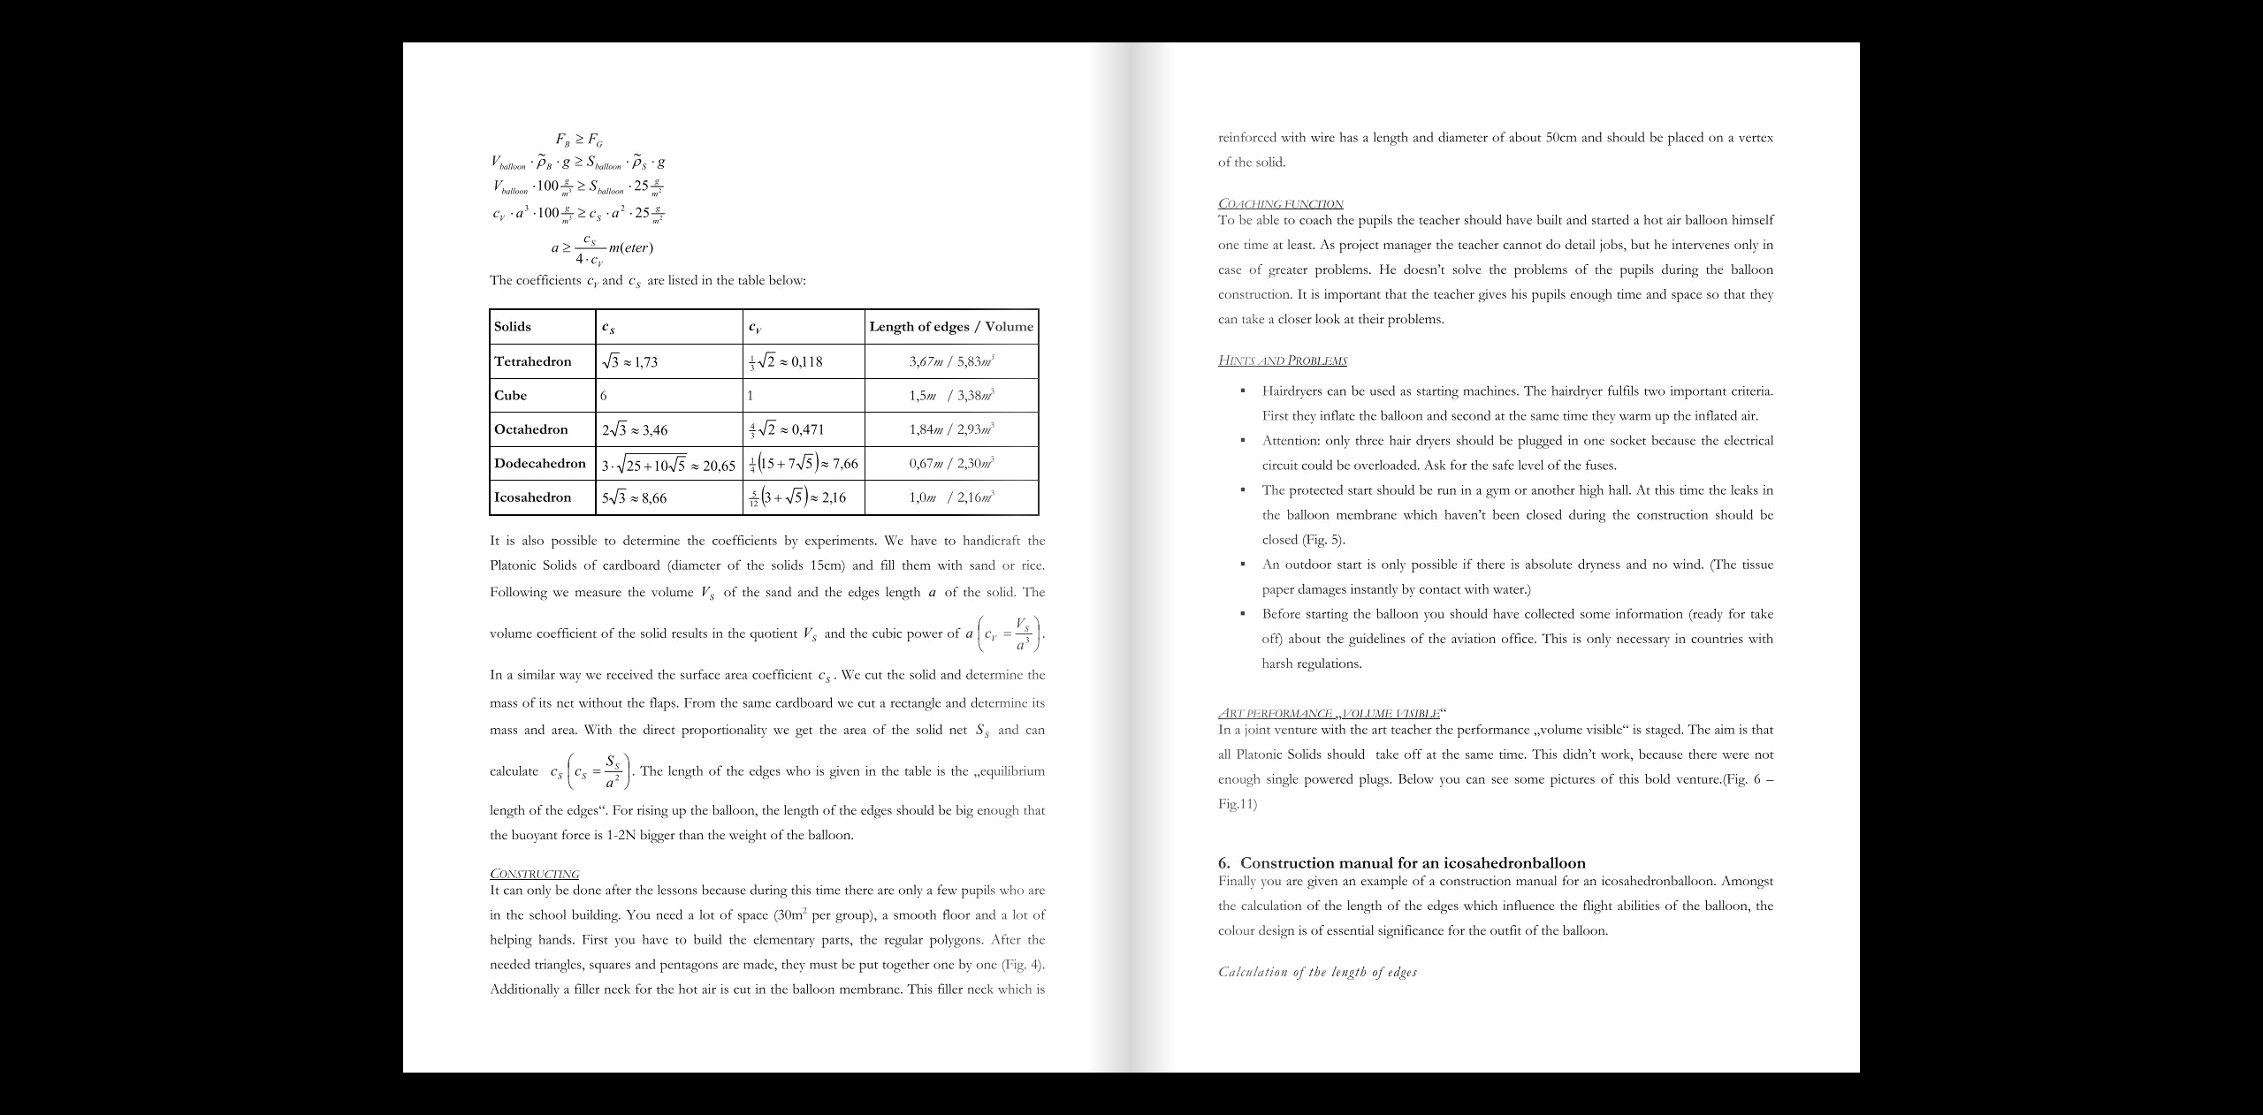

Slide 21
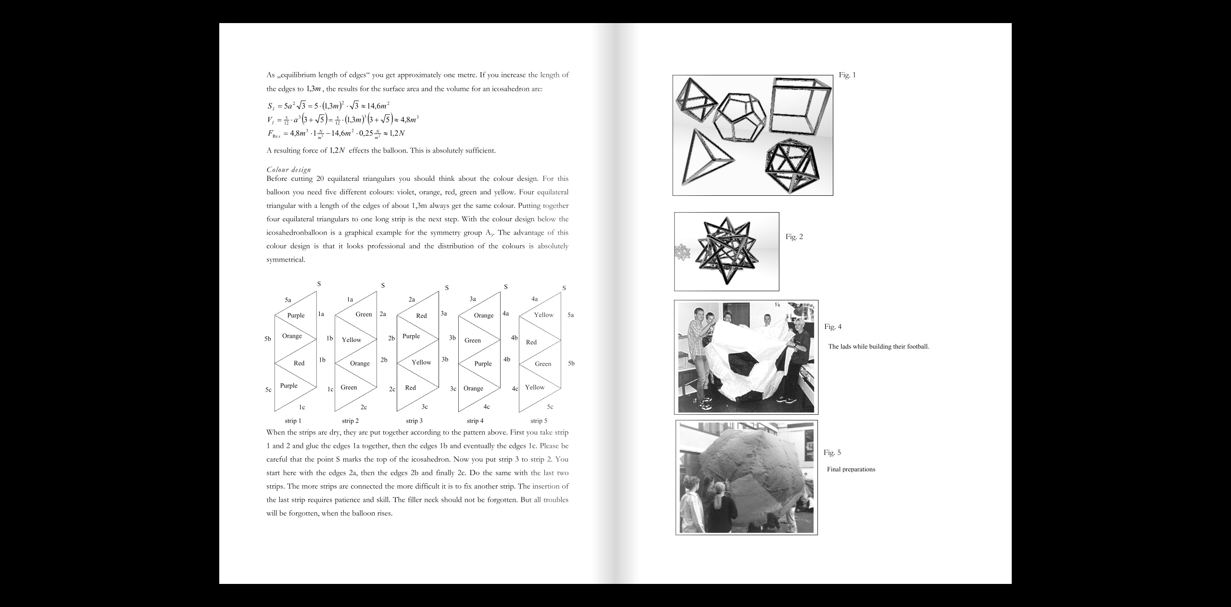

Slide 22
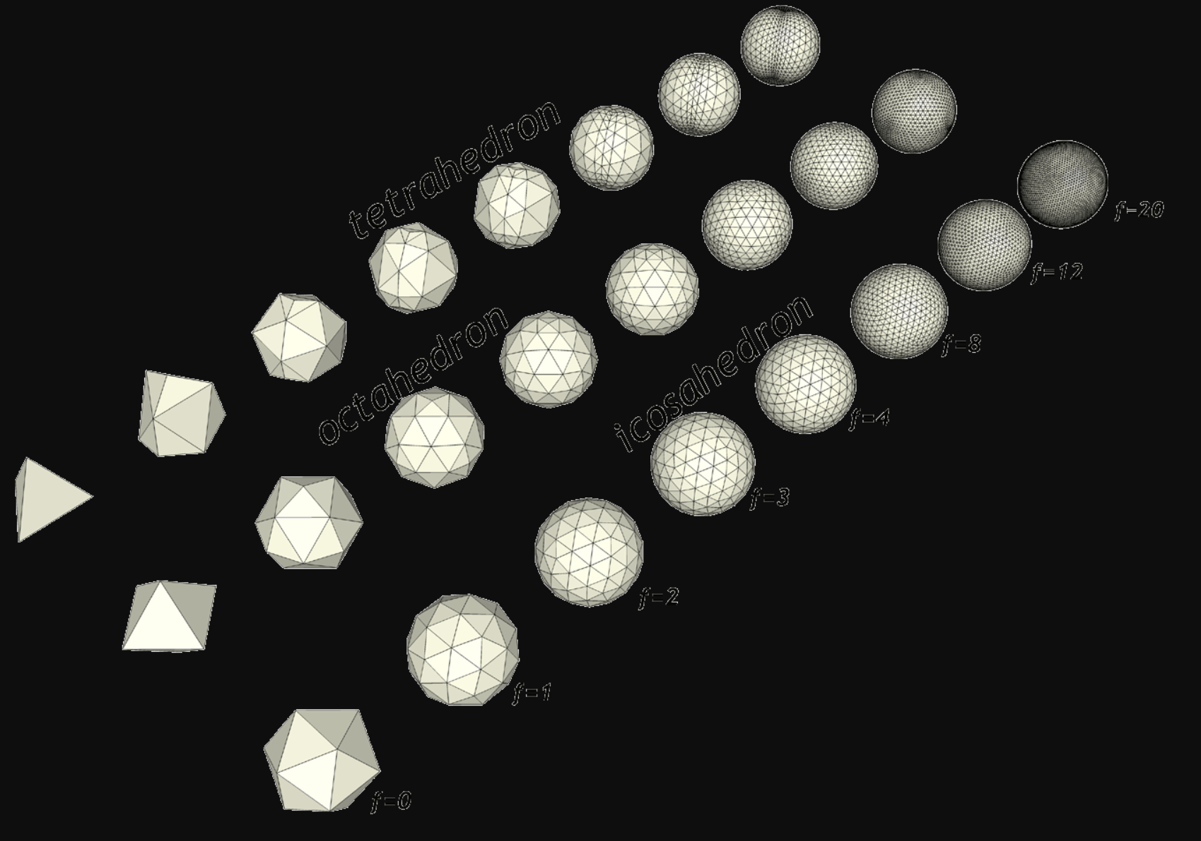
http://rubyquiz.com/quiz3.html http://phrogz.net/CSS/Geodesics/VariousGeodesics_planar.png

Slide 23
From “Euler's gem : the polyhedron formula and the birth of topology”
There are exactly five regular polyhedra:
Three of the shapes are composed of equilateral triangular faces—the tetrahedron (the 4-sided pyramid), the octahedron (the double-pyramid with 8 faces), and the 20-sided icosahedron. The cube is composed of 6 squares and the dodecahedron is the 12-sided figure made of regular pentagons. (Appendix A contains templates for making the regular polyhedra out of paper.)
Euler’s Polyhedron Formula
A polyhedron with V vertices, E edges, and F faces sastisfies V − E + F = 2.

Slide 24
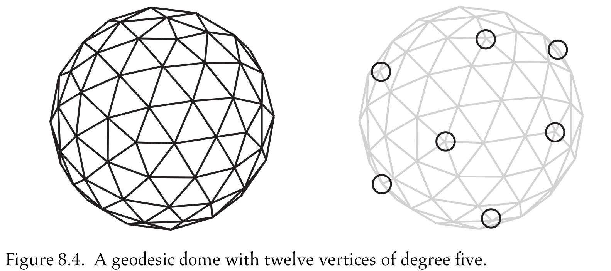
From “Euler's gem : the polyhedron formula and the birth of topology”
If every face of a polyhedron is a triangle and the degree of every vertex
is five or six, then the polyhedron has exactly twelve vertices of degree
five.

Slide 25
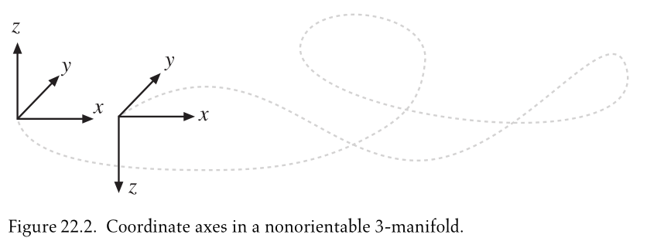
From “Euler's gem : the polyhedron formula and the birth of topology”

Slide 26
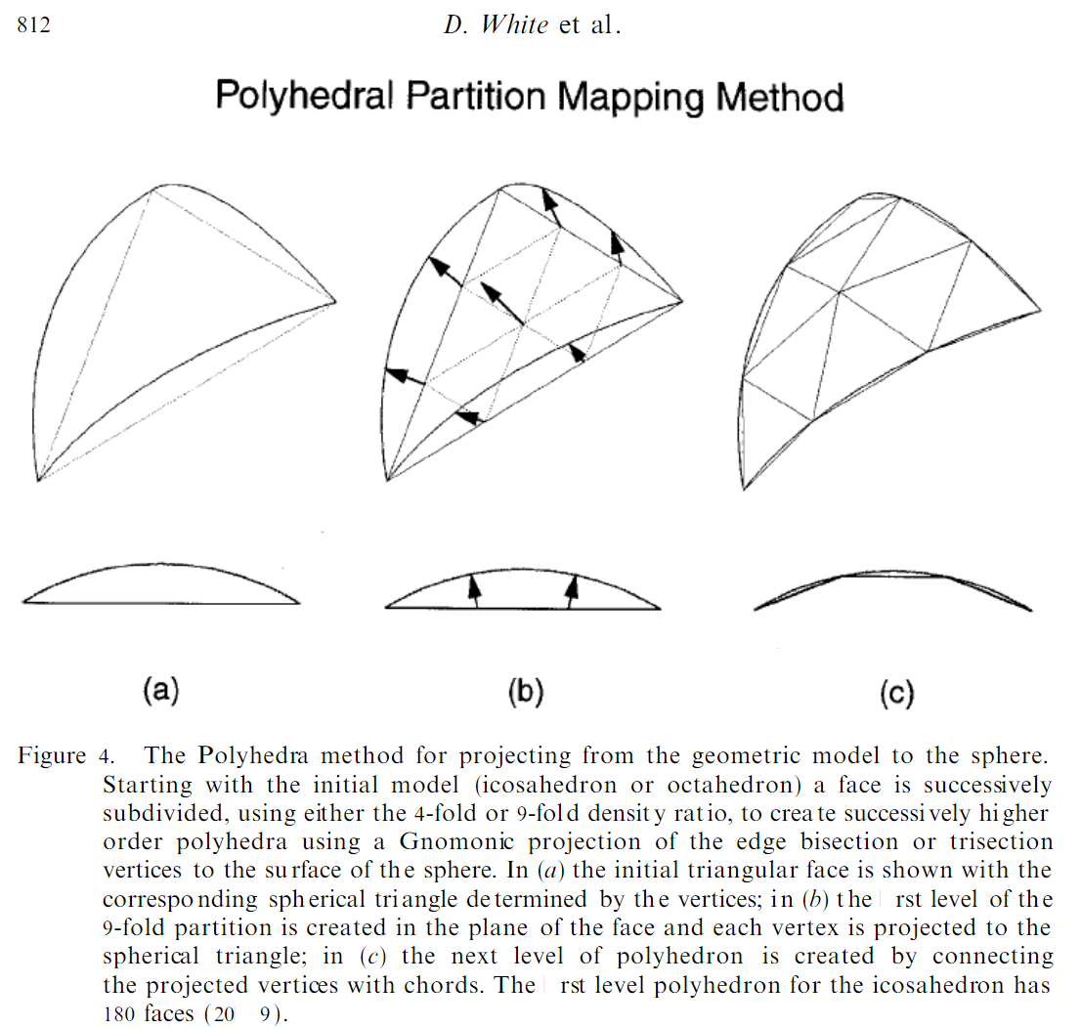
https://www.researchgate.net/publication/220649496_Comparing_Area_and_Shape_Distortion_on_Polyhedral-Based_Recursive_Partitions_of_the_Sphere

Slide 27
